Slide 1
Potato Leaves Diseases Detection using Deep Learning
Submitted by
Dola Saha
Sumsun Nahar
Tariqul Islam
Md Raihanur Rahman
Rumon Islam
Our Supervisor
Md. Rezaul Islam
Lecturer
Dept. of CSE
Dhaka International University

Slide 2
Overview
Potato is a highly-successful and most favorite garden vegetable in the world.
After rice and wheat, potato is the 3rd most important crop in Bangladesh to enhance economic growth.
Bangladesh is the 4th potato-producing country in Asia and hold 7th position throughout the world.
Despite the hype, potato leaf disease causes significant damage to the potatoes.
Various types of diseases such as Early blight, Late blight, Alternaria Solani, Potato roll leaf virus, Insect infected etc

Slide 3
Previous Work
Reference | Methodology | Disease | Dataset | Accuracy
1.Weirong C. et al. 2023 | MobileNet -V2 | 3 Classes (Early Blight, Healthy, Late Blight) | PlantVillage | 97.73%
2. Kamal, K. et al. 2019 | Modified MobileNet | 3 Classes (Early Blight, Healthy, Late Blight) | PlantVillage | 98.34%
3. Liang, Q. et al. 2019 | ResNet50 | 3 Classes (Early Blight, Healthy, Late Blight) | PlantVillage | 98%
4.Krizhevsky, A. et al. 2012 | AlexNet, Overfeat Multiple AlexNetOWTBn, VGG and GoogLeNet | 3 Classes (Early Blight, Healthy, Late Blight) | PlantVillage | 99.53%
5. Khalifa, N.E.M. et al. 2021 | CNN | Binary (Early Blight and Late Blight) | PlantVillage | 98%
6. Sanjeev, K. et al. 2020 | FFNN | Binary (Early Blight and Late Blight) | PlantVillage | 96.5%

Slide 4
Previous Work
Reference | Methodology | Disease | Dataset | Accuracy
7. Rabbia, M. et al. 2022 | DenseNet201 | 5 classes (Early Blight, Healthy, Late Blight, Leaf Roll, Potato Verticillum_wilt) | PlantVillage, Manual | 97.2%
8. Rozaqi, A.J. et al. 2020 | CNN | Binary ( Early Blight and Late Blight) | PlantVillage | 92%
9. Barman, U. et al. 2020 | SBCNN | Binary ( Early Blight and Late Blight) | PlantVillage | 96.75%
10. Tiwari, D. et al. 2020 | SVM, KNN and Neural Net | Binary ( Early Blight and Late Blight) | PlantVillage | 97.8%
11. Lee, T.Y. et al. 2020 | CNN | Binary ( Early Blight and Late Blight) | PlantVillage | 99%
12. Islam, M. et al. 2017 | Segment and Multi SVM | Binary ( Early Blight and Late Blight) | PlantVillage | 95%

Slide 5
Our Previous Dataset
Label | Category | Source | Number | Training set | Test set
1 | Early Blight General | PlantVillage | 1628 | 1298 | 330
2 | Early Blight Serious | Collected from Google | 1055 | 758 | 297
3 | Late Blight | PlantVillage | 1424 | 1149 | 275
4 | Healthy | PlantVillage | 1020 | 745 | 275
5 | Insect infected | Collected from Google | 302 | 214 | 88
6 | Leaf Roll | Collected from Google | 180 | 136 | 44
7 | Virus infected | Collected from Google | 1012 | 803 | 209

Slide 6
New Dataset before Augmentation
Class | Name of Diseases | No of total Images | No. of train images | No. of test images
Three-class classification | Early Blight | 1006 | 800 | 206
 | Late Blight | 1000 | 800 | 200
 | Healthy | 1005 | 800 | 205
Seven-class classification | Early Blight General | 1006 | 800 | 206
 | Early Blight Serious | 1078 | 800 | 278
 | Late Blight | 1000 | 800 | 200
 | Healthy | 1005 | 800 | 205
 | Insect | 1016 | 810 | 206
 | Potato Leaf Roll Virus | 853 | 653 | 200
 | Potato Leaf Virus | 1000 | 800 | 200

Slide 7
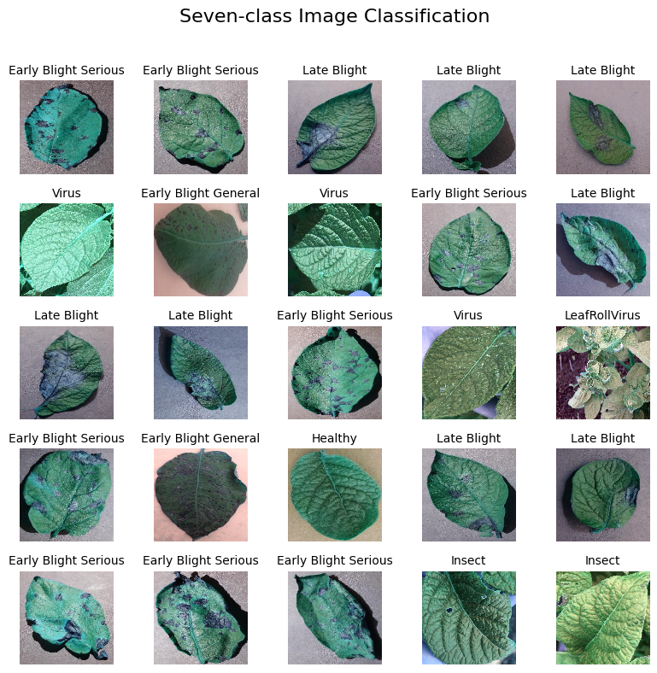
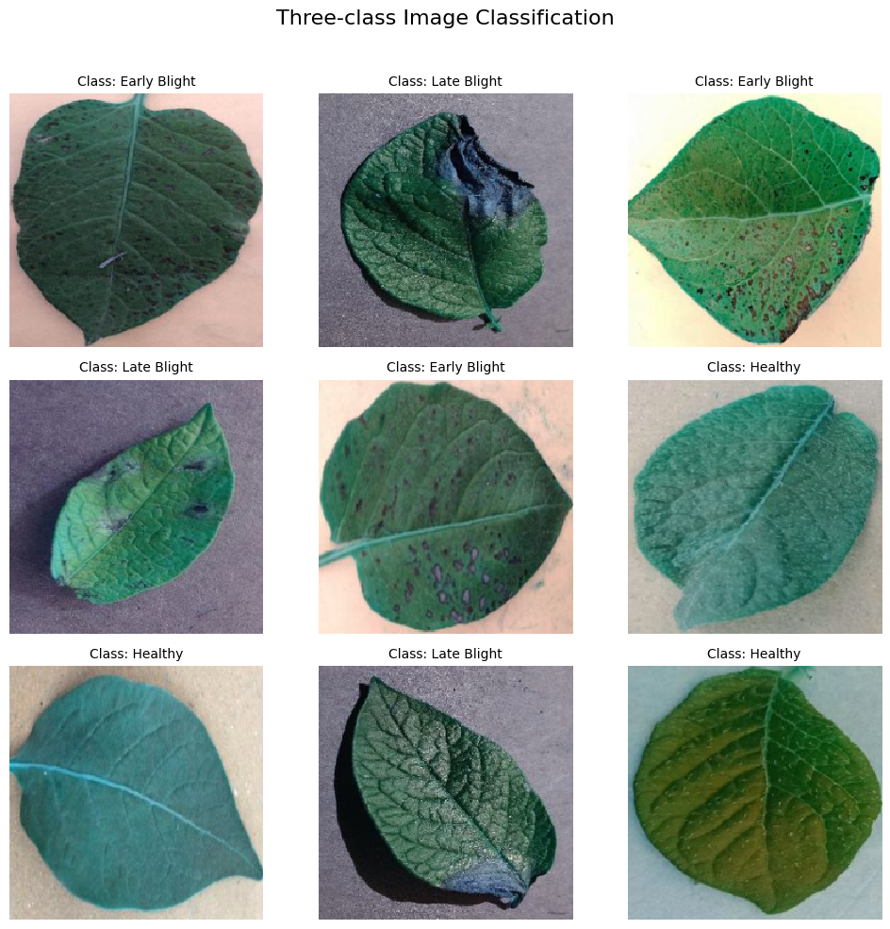
Data Visualization

Slide 8
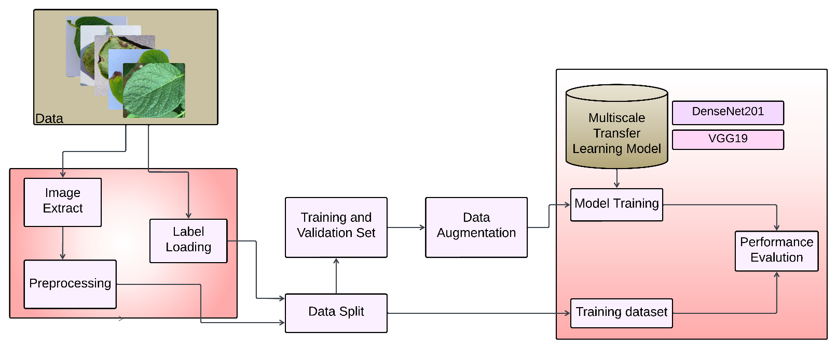
Approached Model
Figure 2: Previous Proposed MultiNet Framework for the classification of Potato disease

Slide 9
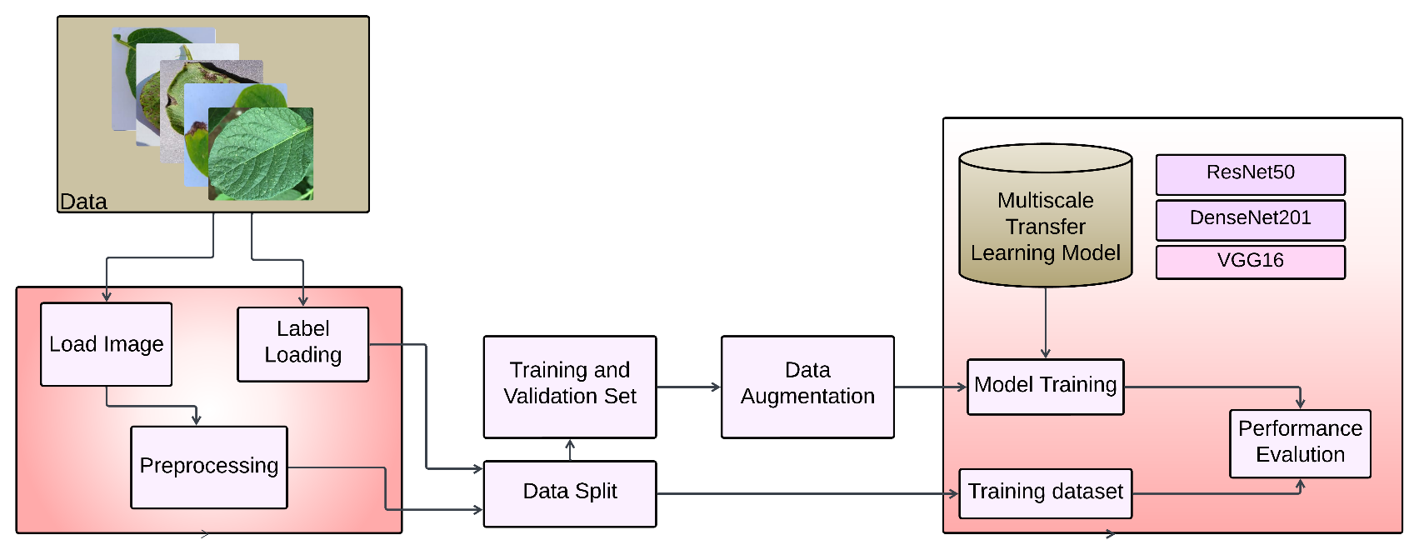
Approached Model
Figure 3: Proposed MultiNet Framework for the classification of Potato disease

Slide 10
Data Augmentation
Number | Data Augmentation technique | Parameter value
1 | Zooming Range | 2
2 | Rotation Range | 90
3 | Shearing Range | .5
4 | Width Shift Range | .4
5 | Height Shift Range | .4
6 | Horizontal Flip | True
7 | Vertical Flip | True

Slide 11
New Dataset before Augmentation
Class | Name of Diseases | No of total Images | No. of train images | No. of test images
Three-class classification | Early Blight | 7042 | 5600 | 1442
 | Late Blight | 7000 | 5600 | 1400
 | Healthy | 7035 | 5600 | 1435
Seven-class classification | Early Blight General | 7042 | 5600 | 1442
 | Early Blight Serious | 7546 | 5600 | 1946
 | Late Blight | 7000 | 5600 | 1400
 | Healthy | 7035 | 5600 | 1435
 | Insect | 7112 | 5670 | 1442
 | Potato Leaf Roll Virus | 5971 | 4571 | 1400
 | Potato Leaf Virus | 7000 | 5600 | 1400

Slide 12
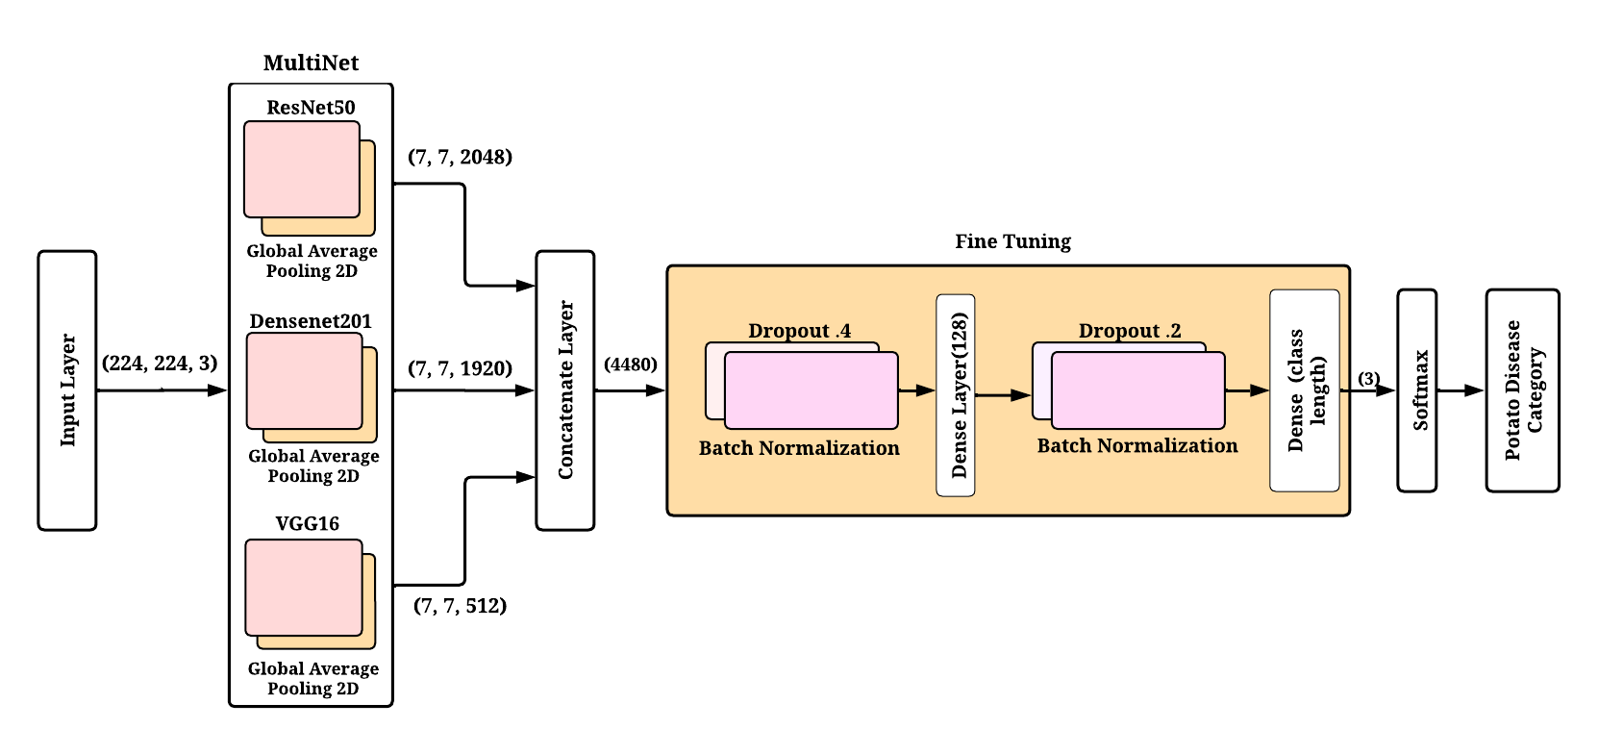
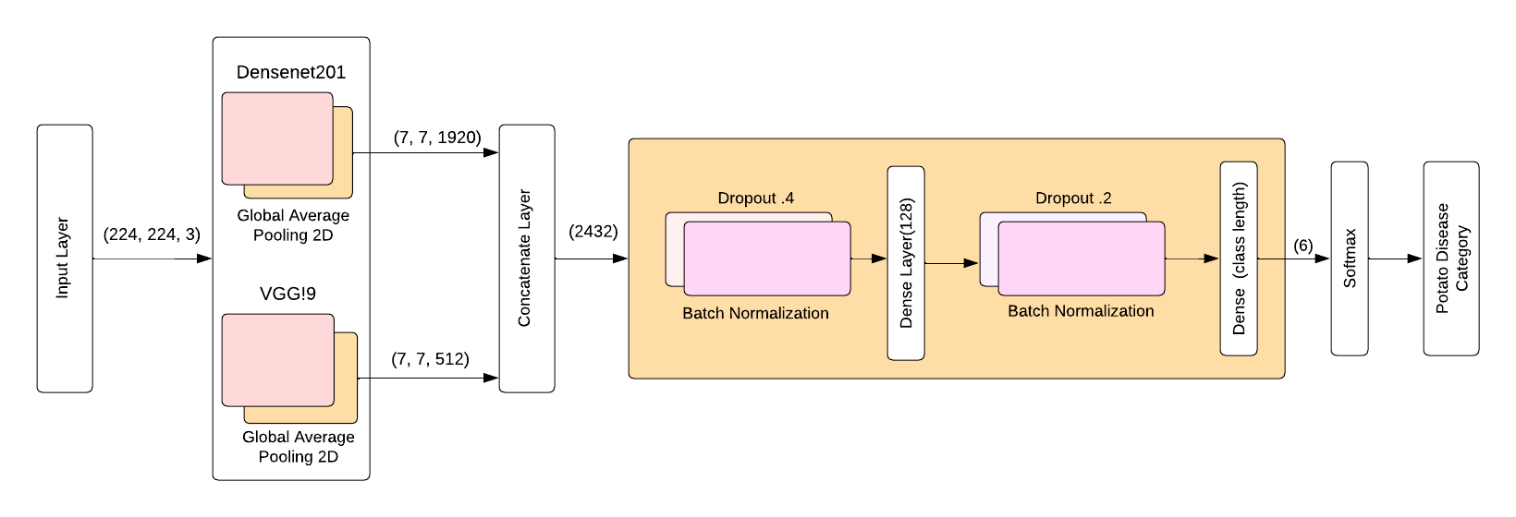
Approached MultiNet Framework
Figure 4: Fine-tuned MultiNet Framework for the classification of Potato disease

Slide 13
Model Summary
Layer (type) | Output Shape | Param # | Connected to
input_1 (InputLayer) | [(None, 224, 224, 3)] | 0 | [ ]
resnet50 (Functional) | (None, 7, 7, 2048) | 23587712 | ['input_1[0][0]']
densenet201 (Functional) | (None, 7, 7, 1920) | 18321984 | ['input_1[0][0]']
vgg16 (Functional) | (None, 7, 7, 512) | 14714688 | ['input_1[0][0]']
global_average_pooling2d (GlobalAveragePooling2D) | (None, 2048) | 0 | ['resnet50[0][0]']
global_average_pooling2d (GlobalAveragePooling2D) | (None, 1920) | 0 | ['densenet201[0][0]']
global_average_pooling2d (GlobalAveragePooling2D) | (None, 512) | 0 | ['vgg16[0][0]']
concatenate (Concatenate) | (None, 4480) | 0 | ['global_average_pooling2d[0][ 0]', 'global_average_pooling2d_1[0][ 0]', 'global_average_pooling2d_2[0][ 0]']
dropout (Dropout) | (None, 4480) | 0 | ['concatenate[0][0]']
batch_normalization (BatchNormalization) | (None, 4480) | 17920 | ['dropout[0][0]']
dense (Dense) | (None, 128) | 573568 | ['batch_normalization[0][0]']
dropout_1 (Dropout) | (None, 128) | 0 | ['dense[0][0]']
batch_normalization_1 (BatchNormalization) | (None, 128) | 512 | ['dropout_1[0][0]']
dense_1 (Dense) | (None, 3) | 387 | ['batch_normalization_1[0][0]']
Total params: 57216771 (218.26 MB) Trainable params: 56925379 (217.15 MB) Non-trainable params: 291392 (1.11 MB)

Slide 14
Algorithm
Algorithm 1: Identification and Categorization of Potato Leaf Diseases
Input: Potato Disease Training Set T1, Validation set V1, and Testing set T2 Learning rate (a) Number of Epochs (b) Batch size (c) The total number of images that each batch covers (d) Output: w -> CNN pre-trained models’ weight. Start: Transform individual image in the training set into dimensions 224 x 224. Employ a data augmentation technique to increase the size of the dataset. Retrieve features from the images by utilizing pre-existing CNN models such as ResNet50, DenseNet-201, and VGG16. Merge the extracted characteristics by employing concatenate layers. Configure the fine-tuning layers such as dense, batchnormalization, dropout, and softmax. Initialize the parameters of the pre-trained CNN model as a, b, c, d. Assess the proposed framework to determine and confirm the initial weights. for each iteration from 1 to b: Choose a batch of size d from T1. Compute the loss function and carry out forward propagation. Apply backpropagation to optimize and modify the weights indicated by 'w.'. end for

Slide 15
The Parameters Utilized During The Training Stage
Dataset | Parameter | Value
Three-class and seven-class classification | Optimizer | adam
 | Learning Rate | .0001
 | Loss Function | categorical_crossentropy
 | Metrics | accuracy
 | Batch Size | 32
 | Epochs | 50

Slide 16
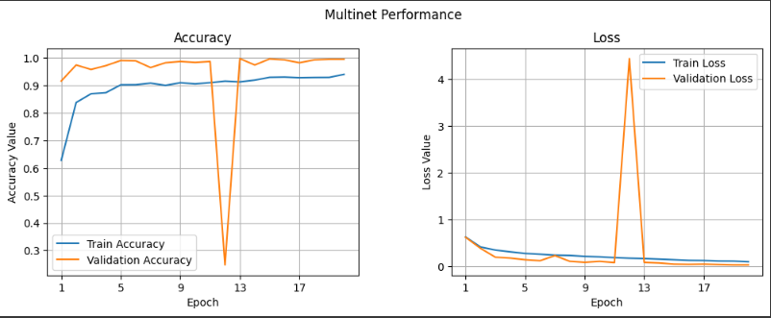
Previous MultiNet Performance
Figure 5: Training advancement for the previous dataset: (a) accuracy in training and validation (increased values indicate improved performance), and (b) loss in training and validation (decreased values indicate improved performance).

Slide 17
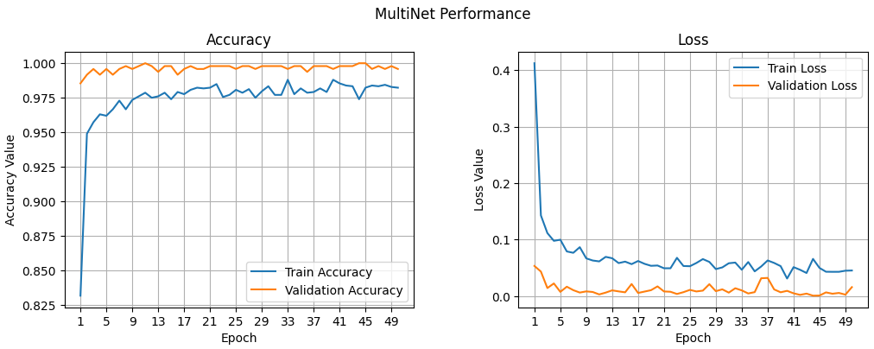
Multinet Performance For Three-class
Figure 6: Training advancement for the three-class dataset: (a) accuracy in training and validation (increased values indicate improved performance), and (b) loss in training and validation (decreased values indicate improved performance).

Slide 18
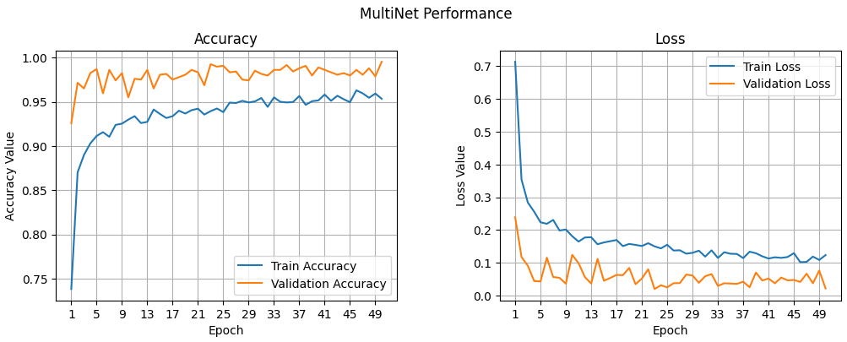
Multinet Performance For Seven-class
Figure 7: Training advancement for the seven-class dataset: (a) accuracy in training and validation (increased values indicate improved performance), and (b) loss in training and validation (decreased values indicate improved performance).

Slide 19
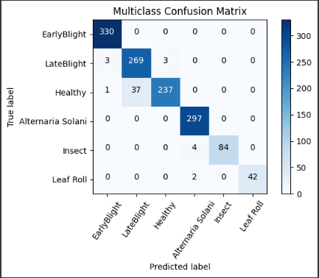
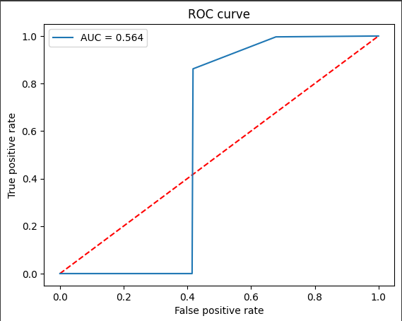
Previous Confusion Matrix and ROC Curve
Figure 8: The evaluation of the 'MultiNet' infrastructure on a previous dataset, including a) Three-class Confusion Matrix and b) ROC curve analyses

Slide 20
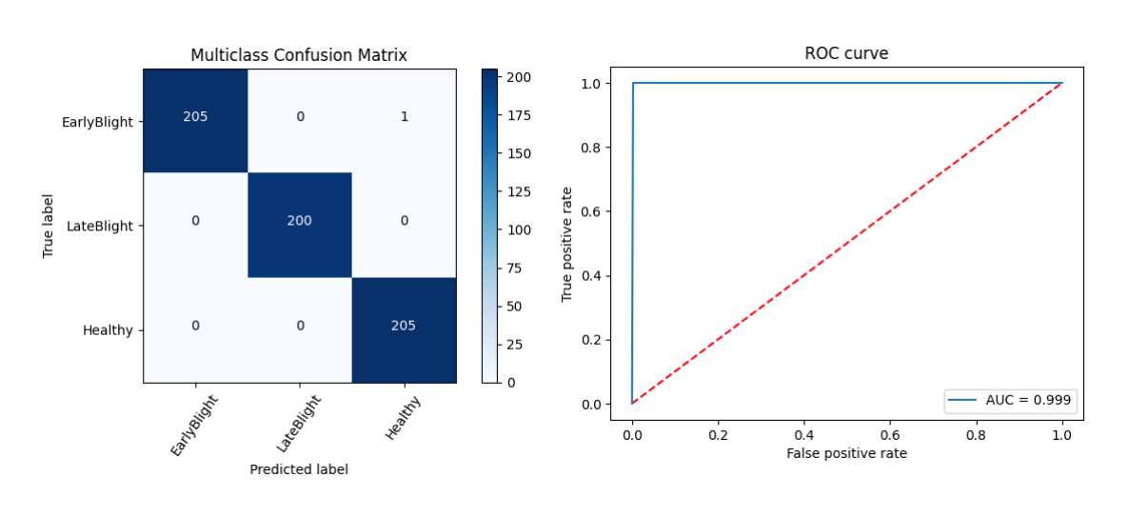
Present Confusion Matrix And ROC Curve For Three-classes
Figure 9: The evaluation of the 'MultiNet' infrastructure on a three-class dataset, including a) Three-class Confusion Matrix and b) ROC curve analyses

Slide 21
Classification Report on three-classes Dataset
Class | Precision | Recall | F1-score | Support
Early Blight | 1.00 | 1.00 | 1.00 | 206
Late Blight | 1.00 | 1.00 | 1.00 | 200
Healthy | 1.00 | 1.00 | 1.00 | 205
Accuracy |  |  | 1.00 | 611
Macro avg | 1.00 | 1.00 | 1.00 | 611
Weighted avg | 1.00 | 1.00 | 1.00 | 611

Slide 22
Comparison Of Proposed Model With State-of-the Art Model
Model | Class 3
 | Accuracy | F1-Score | Precision | Recall | MSE | MAE
VGG16 | .995 | .995 | .995 | .995 | .015 | .008
VGG19 | .995 | .995 | .995 | .995 | .020 | .010
ResNet-50 | .961 | .961 | .961 | .961 | .152 | .077
DenseNet-201 | .993 | .993 | .993 | .993 | .026 | .013
MobileNetV2 | .989 | .989 | .989 | .989 | .040 | .021
NASNetMobile | .980 | .980 | .980 | .980 | .069 | .036
Xception | .997 | .997 | .997 | .997 | .013 | .007
Proposed Method | .998 | .998 | .998 | .998 | .007 | .003

Slide 23
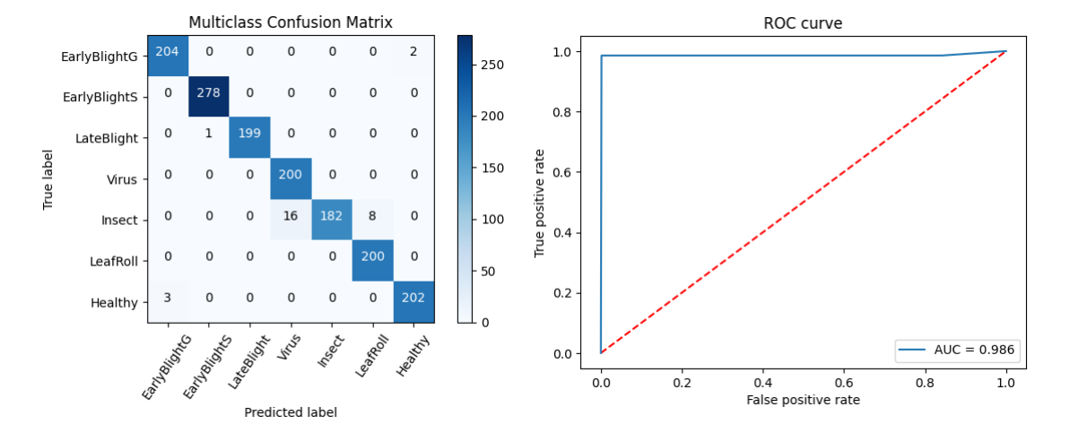
Present Confusion Matrix And ROC Curve For Seven-classes
Figure 10: The evaluation of the 'MultiNet' infrastructure on a seven-class dataset, including a) Seven-class Confusion Matrix and b) ROC curve analyses.

Slide 24
Classification Report on three-classs Dataset
 | precision | recall | f1-score | support
Early Blight General | 0.99 | 0.99 | 0.99 | 206
Early Blight Serious | 1.00 | 1.00 | 1.00 | 278
Late Blight | 1.00 | 0.99 | 1.00 | 200
Healthy | 0.99 | 0.99 | 0.99 | 205
Insect | 1.00 | 0.88 | 0.94 | 206
Potato Leaf Roll Virus | 0.96 | 1.00 | 0.98 | 200
Potato Leaf Virus | 0.93 | 1.00 | 0.96 | 200
Accuracy |  |  | 0.98 | 1495
Macro avg | 0.98 | 0.98 | 0.98 | 1495
Weighted avg | 0.98 | 0.98 | 0.98 | 1495

Slide 25
Comparison Of Proposed Model With State-of-the Art Model
Model | Class 7
 | Accuracy | F1-Score | Precision | Recall | MSE | MAE
VGG16 | .960 | .960 | .960 | .960 | .170 | .076
VGG19 | .794 | .80 | .84 | .794 | 1.60 | .430
ResNet-50 | .978 | .978 | .978 | .978 | .075 | .036
DenseNet-201 | .977 | .977 | .977 | .977 | .072 | .037
MobileNetV2 | .953 | .954 | .961 | .952 | .205 | .072
NASNetMobile | .978 | .978 | .979 | .978 | .119 | .039
Xception | .970 | .970 | .970 | .970 | .099 | .052
Proposed Method | .98 | .98 | .98 | .98 | .137 | .037

Slide 26
Reference | Methodology | Disease | Dataset | Accuracy
1. Chen, J. et al. 2023 | MobileNet -V2 | 3 Classes (Healthy, Late Blight, Early Blight) | PlantVillage | 97.73%
2. Kamal, K. et al. 2019 | Modified MobileNet | 3 Classes (Healthy, Late Blight, Early Blight) | PlantVillage | 98.34%
3. Liang, Q. et al. 2019 | ResNet50 | 3 Classes (Healthy, Late Blight, Early Blight) | PlantVillage | 98%
4. Bonik, C. et al. 2023 | CNN | 3 Classes (Healthy, Late Blight, Early Blight) | PlantVillage | 94.2%
5. Khalifa, N.E.M. et al. 2021 | CNN | Binary (Late Blight and Early Blight) | PlantVillage | 98%
6. Sanjeev, K. et al. 2021 | FFNN | Binary (Late Blight and Early Blight) | PlantVillage | 96.5%
7. Rabbia, M. et al. 2022 | DenseNet201 | 5 classes (Healthy, Late Blight, Early Blight, Leaf Roll, Potato Verticillum_wilt) | PlantVillage, Manual | 97.2%
8. Rozaqi, A.J. et al. 2020 | CNN | Binary (Late Blight and Early Blight) | PlantVillage | 92%
9. Barman, U. et al. 2020 | SBCNN | Binary (Late Blight and Early Blight) | PlantVillage | 96.75%
10. Tiwari, D. et al. 2020 | SVM, KNN and Neural Net | Binary (Late Blight and Early Blight) | PlantVillage | 97.8%
11. Lee, T.Y. et al. 2020 | CNN | Binary (Late Blight and Early Blight) | PlantVillage | 99%
12. Islam, M. et al. 2017 | Segment and Multi SVM | Binary (Late Blight and Early Blight) | PlantVillage | 95%
13. Proposed Method | ResNet-50+DenseNet-201+VGG16 | MultiClass (Early Blight, Late Blight, and Healthy) | PlantVillage | 99.84%
14. Proposed Method | ResNet-50+ DenseNet-201+VGG16 | MultiClass (Early Blight General, Early Blight Serious, Late Blight, Healthy, Insect infected, LeafRollVirus, and Virus infected) | PlantVillage, Manual | 98%

Slide 27
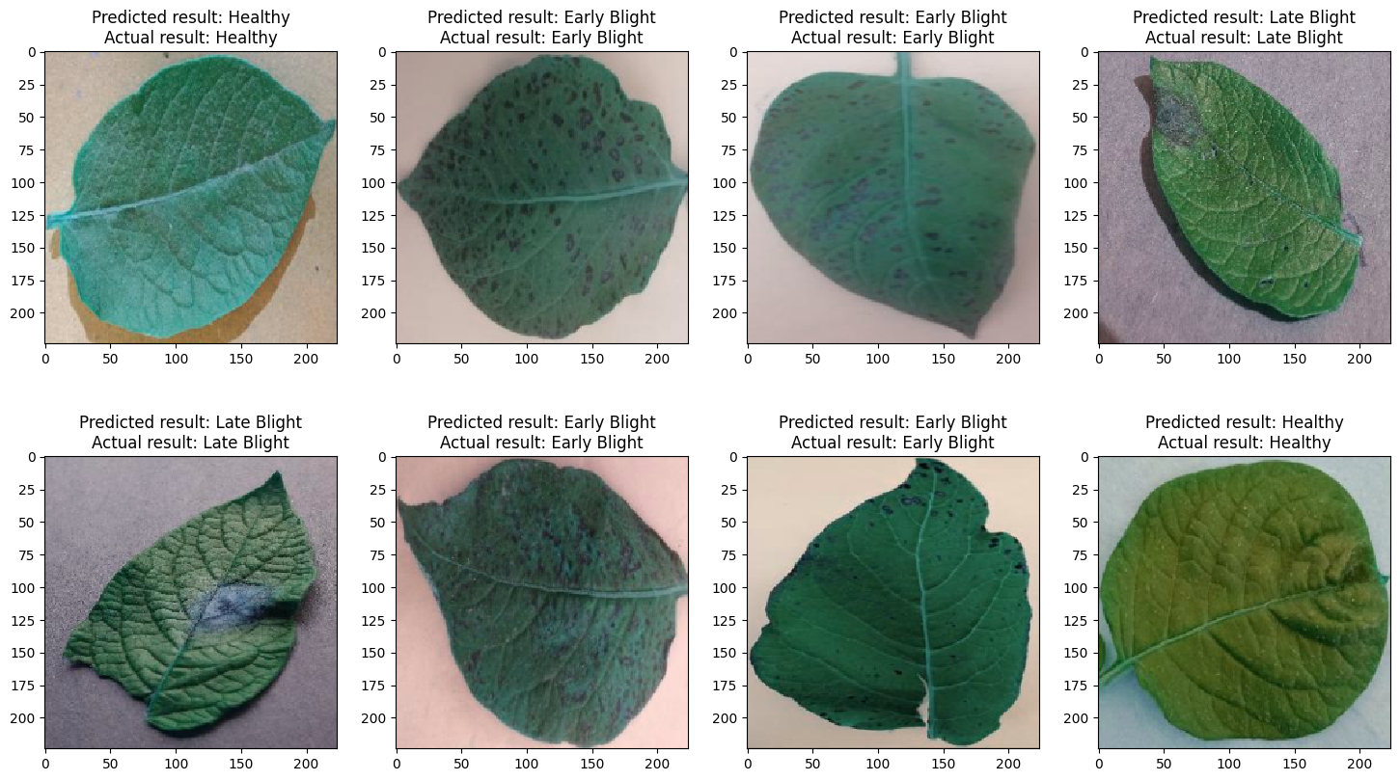
Output
Figure 11: ‘‘MultiNet” predicted three-class dataset image

Slide 28
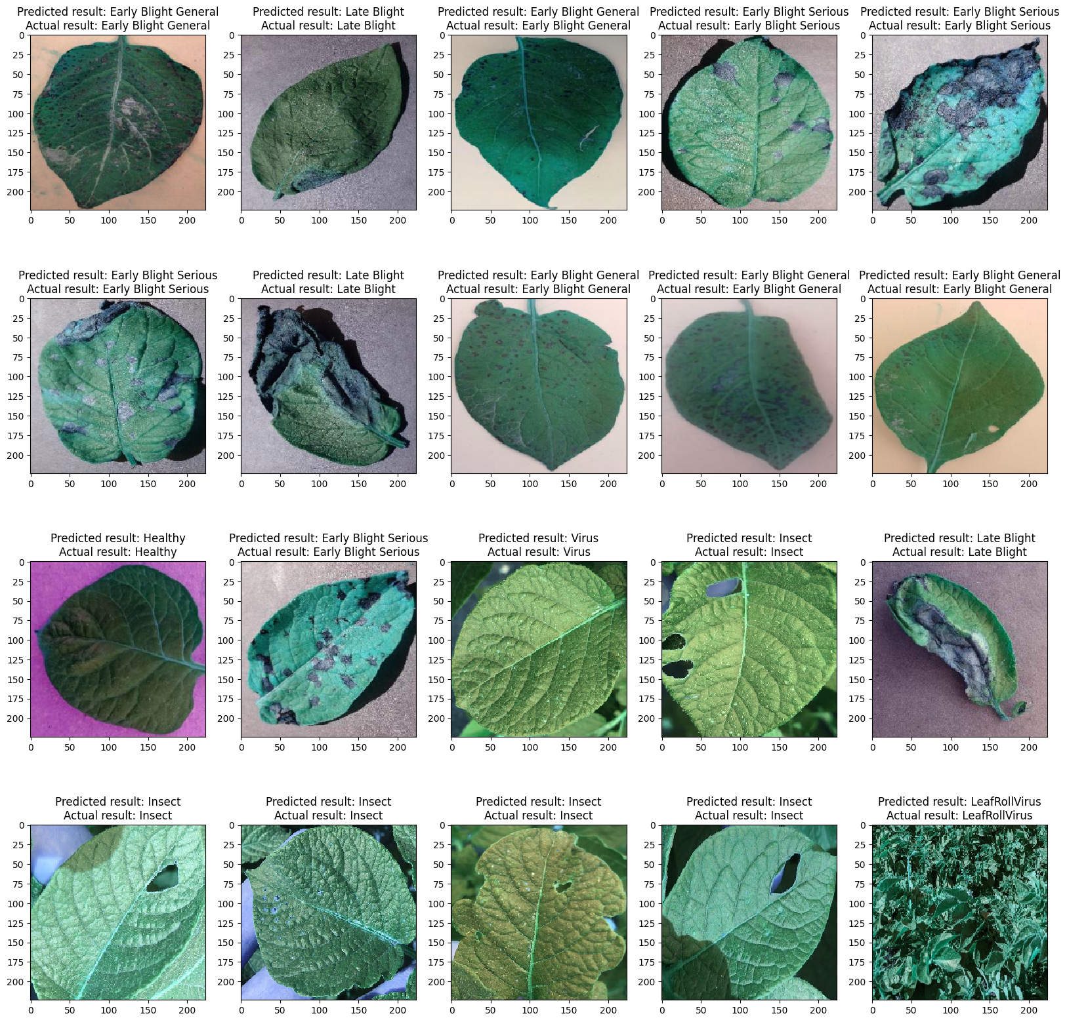
Output

Slide 29
Future Work
The framework will be used in future developments to automatically track and identify a variety of potato disease data on mobile phones and tablets.
Moreover, we are confident that our 'MultiNet' approach could potentially be applicable in other fields, including real-time malfunction evaluation, virtualized rice damage evaluation, and localization for identifying distinct imagery.

Slide 30
Thank you

